Slide 1
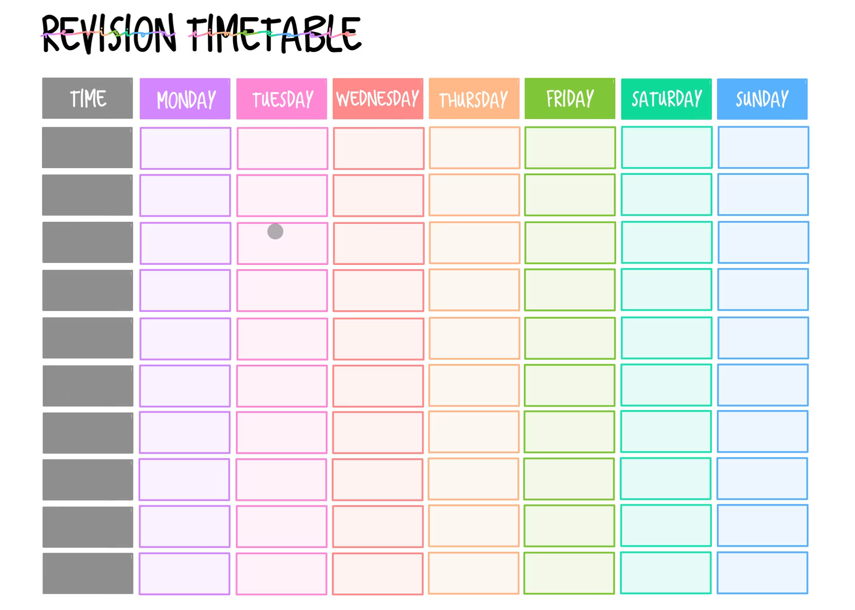
Revision Timetables
A study planner, or revision timetable, is a calendar or diary that includes all your activities, lessons and other commitments. Having a good plan will help you stay motivated and balance your time across different subjects.

Slide 2
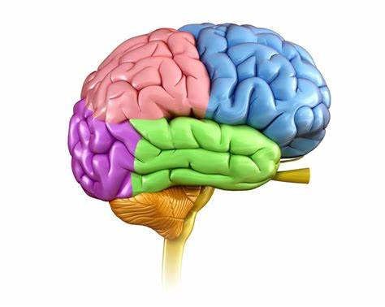
Memory and Revision
Our memory is split into two key parts.
Short term memory: what information we can hold about a topic in our heads as soon as we hear about it. This is the new information you learn in a lesson, like who Scrooge is and what Marley’s Ghost says to Scrooge.
The short term memory is very small and can only hold about 7 new bits of information at once. This is why we forget things. Distractions, such as noise from other pupils or things outside the classroom, attack our short term memory and fill up the 7 things with information we don’t need. This makes it harder to learn.

Slide 3
Memory and Revision
Long term memory: this is the information that you can remember outside the classroom. Facts in your long term memory never go away and are stored forever. This is how you can remember your own address, an important person’s phone number, or football facts about your team. You don’t need to revise this information to remember it because it's now stored in your long term memory.

Slide 4
Memory and Revision
So what is revision?
Revision is about moving things from our short term memory to our long term memory. We do this by practicing important information and making it stick. This is learning. You’ve only learnt what you can remember without help.

Slide 5
Breaking Up Revision
Revision can be overwhelming!
It’s important that we know we don’t have to revise everything at once.
Just like learning any new skill, we need to break down our revision into little chunks that are more approachable.
We should plan this out in our week so our short term memory isn’t too overloaded.

Slide 6
Timetabling Your Revision
Day | Monday | Tuesday | Wednesday | Thursday | Friday | Saturday | Sunday
Time
Time
Time
Time

Slide 7
Timetabling Your Revision
Day | Monday | Tuesday | Wednesday | Thursday | Friday | Saturday DAY OFF | Sunday
4:00-4:30 | Maths Equations | English Lit A Christmas Carol | Biology | CLUB | English Lang Q3 Structure |  | English Lit An Inspector Calls
4:30-5:00 | Geography | Physics | Maths Trigonometry | CLUB | P.E |  | Chemistry
5:00-5:30 | BREAK | BREAK | BREAK | English Lit Poetry | BREAK |  | BREAK
5:30-6:00 | P.E | English Lang Q5 Creative Writing | Chemistry | Geography | Maths Graphs |  | Physics

Slide 8
Top Revision Tip
Revise in small bursts of 20-30 minutes for each subject.
Break up your revision with mind maps, images and varied activities to keep your brain engaged.

Slide 9
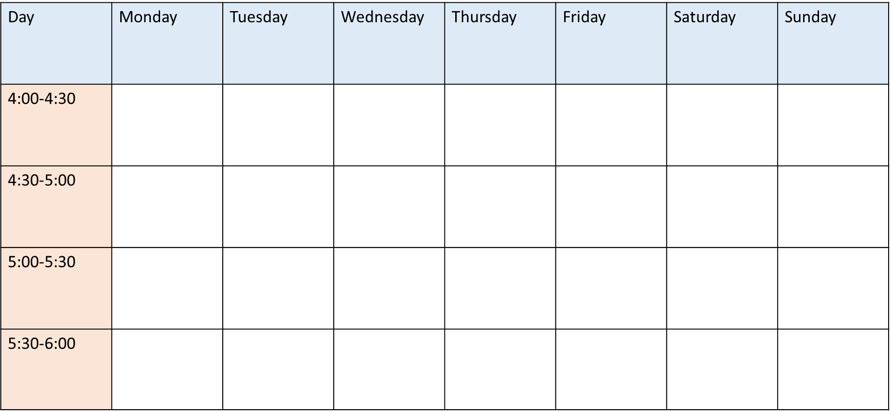
Over to You
I will be sending out a template for revision timetables to your tutors.
Have a go at creating your own revision timetable and stick to it for your mock exams in May.

