Slide 1


Aim Higher 2023 Realising Potential
Mrs K Greenwood- Senior leader
Mr M Russell- Assistant Head/Director of 6th form
Mrs G Taylor Progress leader Year 10

Slide 2
Welcome
The purpose of tonight is to help raise the aspirations of our students.
Every student in the room has potential
Our focus tonight is about providing a starting point for the future doctors, business leaders, lawyers, teachers and nurses...
The list is endless!

Slide 3
Plan for this evening…
Part 1- Aspirations and Potential
Pathways, careers, university.
Kingsmead 6th form
Year 10 and 11 tips- for success
Part 2- Taster workshops (Small groups)
Follow your choice of workshops:-
University Finance/ Russell group Universities
Into to Apprenticeships
Careers options/ What employers are looking for
The UCAS/GCSE/apprenticeship experience

Slide 4
Post 16 – Options
Sixth Form – A Levels and vocational courses
College – A range of vocational courses on offer
Apprenticeships – Level 2 or 3
Traineeships with a training provider for those with low entry grades.
Grade 4s in Maths and English at GCSE if not students must continue to work towards these until they are 18 regardless of the chosen pathway.

Slide 5

At Kingsmead…
Resilient
Driven
Independent
Curious
Problem solvers
Employable

Slide 6
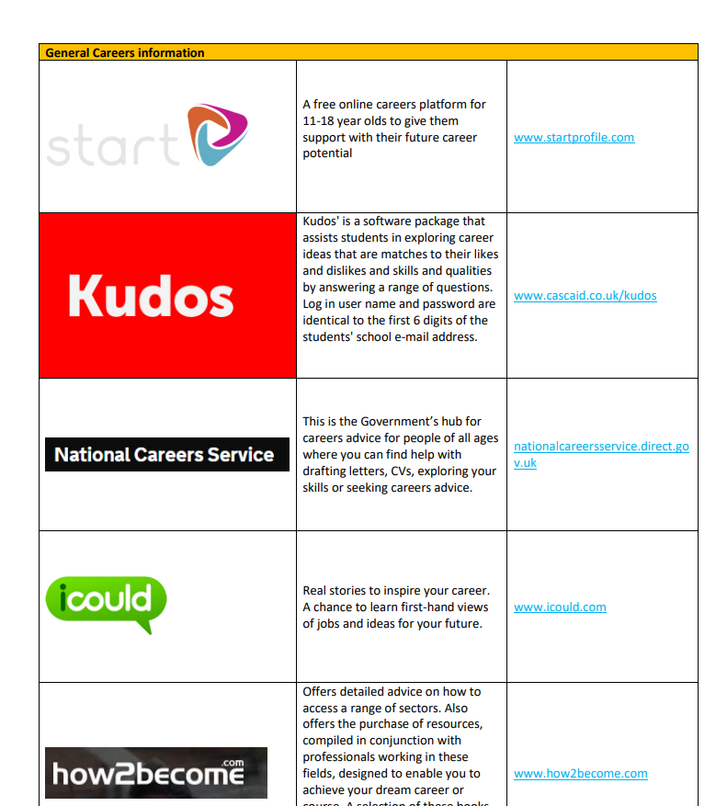
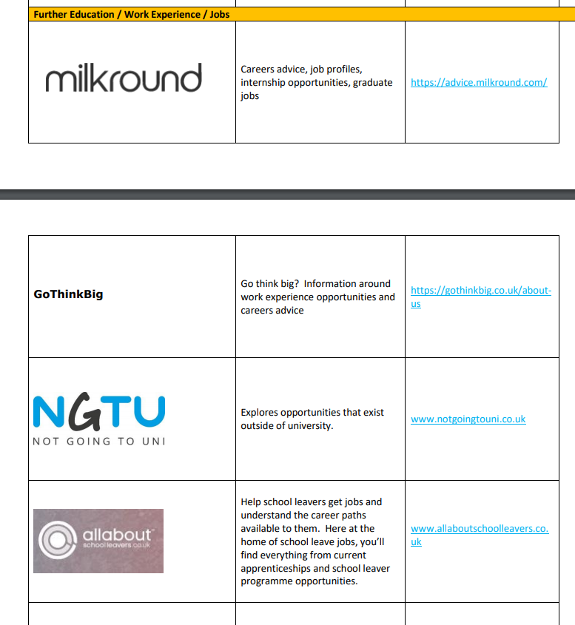
What is out there?
Go to www.kingsmeadschool.net
< academic excellence > < careers provision > < student links > or <parent links>

Slide 7
University Ranking Lists
University (Overall)
Cambridge
Oxford
Warwick
Bristol
Birmingham
Nottingham
York
Sheffield
Liverpool
Keele
There are lots of university rankings that come out each year.… for overall university… the best courses… employability… nightlife…
They are a bit like football league tables!
Aim high- Look at Russell group Universities
You are paying for your university course and its benefits will have a major influence on your later life.
Do your Research!
www.ucas.com
www.opendays.com
Source:
www.thecompleteuniversityguide.co.uk

Slide 8
Why Kingsmead Sixth Form?
Kingsmead School is currently the 5th highest performing and most over-subscribed school in Staffordshire
Kingsmead Sixth Form boasts an array of high-quality courses and highly-trained specialists teachers – the broadest curriculum offer in the district
Our popularity means that we can offer courses that other schools just can’t afford to staff and run
Kingsmead School was rated as “Good with aspects that are Outstanding” by Ofsted in December 2021
Kingsmead Sixth Form achieves outcomes that are significantly above national average every year!
We have 150 applications for the current Year 12 cohort
We have excellent facilities
We have a dedicated Sixth Form Study Centre and Glasshouse
We have a dedicated Sixth Form library
We offer a whole host of dynamic extra-curricular opportunities that look excellent on a UCAS application – leadership, medicine, performing arts, the EPQ, debate, academic coaching and many more!...

Slide 9
Looking to Sixth Form
Kingsmead Sixth Form is an academic Sixth Form which offers a range of pathways:
Academic subjects – linear A-Levels (2 year courses – no AS levels)
Vocational courses – BTEC qualifications (these subjects now have exams which means they are becoming more rigorous)
A combination of both Academic and Vocational
All three pathways have rigorous entry requirements

Slide 10
Grade | Point Score
9 | 9
A* | 8.5
8 | 8
7/A | 7
6 | 6
B | 5.5
5 | 5
4/C | 4
3/D | 3
2/E | 2
1 | 1
APS explained…..
To access Academic courses students MUST have an APS of 5.5
To access Vocational courses students MUST have an APS 4
For a combination course students MUST have an APS of 5.5
To study Maths/Chemistry/Physics/Biology students MUST have a 7 or A/A* in Maths and Science, as well as an APS of 5.5
Students must pass English and Maths at GCSE, preferably at grade 5

Slide 11
Making the Right Steps Now…
What do you want to be when you’re older?
What subjects do you want to study in Sixth Form that will get you to where you want to go?
You now know what grades you need to get.
Your journey starts now!
The gap between Year 11 and 12 is BIG so get into good study habits NOW
I EXPECT Year 12 and 13 students to be working every weeknight for at least an hour
Success at GCSE really does open up opportunities for your future:
Qualifications open doors
Qualifications give you choices

Slide 12

What next?
Looking ahead to…
… tomorrow…
… next term…
… next year…
… Sixth Form…
… and beyond…
Every Grade Matters…
Year 10 is an important year……..
Working towards GCSE exams
End of year exams May 8th-12th
Promoting a positive ethos for life
Skills
Qualities
The bigger picture
Careers
Contact: n.kendall@kingsmeadschool.net

Slide 13
Common problems with not reaching your full potential at GCSE
You know you could have done better, you did what you had to… | Problem- you will not have the basic skills needed for A level - it is hard to catch up…
You get a lower GCSE average point score/grade… | This will potentially block certain ‘hard’ A-Levels …
You get lower Sixth Form target grades which are based on all GCSE grades… | This will make you less appealing to higher ranked universities who have the very best to choose from…
Your GCSE grades are increasingly checked by the top universities… | The higher ranked universities are looking at all GCSE grades (more than ever) and the English Baccalaureate is likely to become a bigger deal. Apprenticeships are a lot more competitive and look for higher grades.

Slide 14
Year 11 Mock Exams
Mocks 1- November/December
Mocks 2- March
Why? - Prepares for the ‘real thing’/Get to know what works for you
Support available g.taylor@kingsmeadschool.net
Past papers/ Flash cards/ revision guides/mind maps
Parent pay- Guide to revise book £4 and subject revision guides
Blended learning Platform
Seneca
Booster sessions. Holiday school (Feb/ Easter)
Revision techniques support session

Slide 15
Part two of the evening
You should have a personalised programme from the tables at the entrance to this room. This has...
A timetable for this evening with your choices of workshops
Your first workshop will start in just a few minutes. Each session will last 20 minutes (5 minute change over)
If you haven’t got a programme please see the staff just outside the this room at the end. If you have not signed up to workshops we can do this here for you.

Slide 16
Benefits of Uni/Finance | B24
Preparing for top universities(Russell group) | B27
Career options | B22
UCAS/GCSE/6th form experience | B26
Introduction to apprenticeships | B23
Apprenticeship experience | B25
What employers are looking for/Training provider | B12
Making it count/revision techniques | B11

