Slide 1

Icebreaker
Welcome

Slide 2

Unsure which career pathway is right for you?
Advice
National Careers Service
nationalcareers.service.gov.uk
www.sortyourfuture.com
What is it really like?
YouTube
https://www.youtube.com
Icould
home - icould
Job boards and Advice
Indeed
https://uk.indeed.com/career-advice
Total Jobs
https://www.totaljobs.com
Fish4jobs
https://www.fish4.co.uk
Monster Jobs
https://www.monster.co.uk

Slide 3
Employability Skills
Employers will often require their employees to have specific skills based on:
Teamwork
Problem solving
Communication and interpersonal skills
ICT
Numeracy
Customer service skills
Time management

Slide 4

Planning your career pathway
What do I need to learn? What skills need to be developed? | How will this be accomplished? | What help, or support will I need? | What will be the success criteria? | Target dates for completion and review | Who is responsible for arranging training?

Slide 5

Identify own strengths and weaknesses
How do we identify our own strengths?
Notes:
The first step is to examine your strengths, which can include personal qualities, skills and abilities. Ask family and friends for input.
Things that you like to do will often be strengths, simply because you will spend more time focusing on and practising them e.g.
Playing sport Caring for others Working with Numbers
Baking Being Creative Reading

Slide 6

Identify own strengths and weaknesses
How do we identify our weaknesses?
This Photo by Unknown Author is licensed under CC BY
Notes:
Going hand in hand with our strengths is the need to identify our weaknesses.
By doing so, possible failure or lack of achievement can be avoided.
A weakness can be identified from your
past experiences when you put consistent effort into something, but didn’t see any improvement
your desire to do something is lacking.

Slide 7

Addressing weaknesses
How to change our weaknesses to our strengths?
Notes:
It is important to discover ways to turn your weaknesses into strengths.
For example,
If you don’t work quickly, develop your focus to allow you to be more thorough and careful, therefore being concerned with the quality of what you do
If you find being around people makes you nervous, prepare in your quiet time friendly general questions to break the ice with strangers and help you shine.

Slide 8



Improving an area of weakness
Ask for help, involve others
Research / Self study
Join a team
Work experience
Coaching from a colleague or trusted other

Slide 9

What qualities, skills and experiences do you have?
This Photo by Unknown Author is licensed under CC BY

Slide 10
Skills and Qualities
Employers expect that you recognise fully your skills, abilities and personal qualities in order to carry out your role and tasks efficiently and effectively.
During a job interview, a prospective employer will ask questions about your skills and qualities.
Therefore, it is important to be able to recognise these before employment commences.
By understanding your weakness or threats you can plan to overcome these to help secure employment or promotion.

Slide 11

What is a Skill?
A skill can be described as
an ability that you have
something that you are good at doing
Having skills that can be transferred, will enable you to be more flexible as an employee, for example
Communication Dynamic Thinking
Teamwork Problem Solving
Organisational Skills Time-management Skills

Slide 12
Transferable skills
Industries often have in common the need for sets of some transferable skills.
Team Work
Solving problems
Communicating ideas effectively
Decision-making

Slide 13
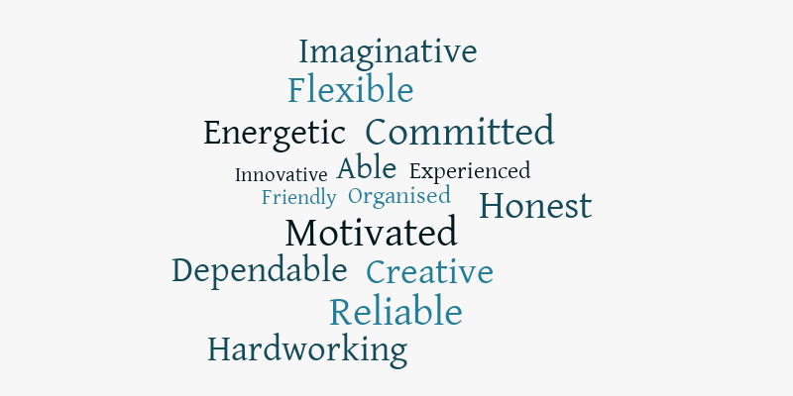
What are Qualities?
Qualities are personal attributes or characteristics such as
They help make you who you are
Employers need to know that employees are motivated, have the self-belief to want to carry out their role successfully, and are trustworthy and reliable

Slide 14
Benefits of setting goals
It enables you to maximise the use of your time
You have a clear and focused direction that gives you a sense of security and purpose
It keeps you moving steadily towards achieving the results you really want and, ultimately, being successful
You retain high levels of enthusiasm for what you want to achieve
You will benefit from increased self-esteem, confidence and belief in your ability to make things happen and feel in control

Slide 15
Pitfalls of setting goals
If goals are too easy, you do not challenge yourself and become bored
If goals are all long-term you begin to feel that you are not achieving anything and lose interest
If goals are not clear and succinct you loose what you are aiming to do and may give up
If you have too many goals you start to feel that you will never achieve them and stop trying to follow them
Try to make sure your plans have a mixture of both long and short term goals that can be achieved. At the end of the year redraft your plan and start again

Slide 16
Reviewing your goals
Plan to review your goals on a regular basis – monthly, bi-monthly, quarterly
Don’t leave reviews too long as you then forget to do what you have planned and the plan fails
At the end of the year redraft your plan and start again. You may keep some ideas or decide to abolish them and add new ones

Slide 17
Personal Skill, Qualities and Experience
A ‘quality’ is something you possess in your personality as a character trait
Honesty
Loyalty
Enthusiasm
sense of humour.
A ‘skill’ is something you possess after gaining knowledge, e.g.
word processing
numeracy tasks
The level and quality of the education/training you acquire is related to your salary prospects and will widen the range of career options available to you.

Slide 18
Experience
‘Experience’ is the term used to describe all the activities you have participated in both at school, work and in your leisure time and what you have learned from them e.g.
Playing sport helps develop teamwork and leadership skills
Helping to care for a child or family member helps develop organisational skills, skills for care or planning activities
Volunteering can help develop confidence, leadership, confidence, work related skills

Slide 19

Why is mindset important?
Determines how you make sense of the world and yourself
Influences how you think, feel, and behave
Influences success or failure
www.bctg.org.uk
This Photo by Unknown Author is licensed under CC BY
Notes:
Setting yourself up to fail before you even start.

Slide 20

Mindset qualities for employers
Notes:
Ask the group - What are they looking for?

Slide 21

Types of mindset
Fixed mindset
Set in ways/believes abilities are fixed
Does not believe it is possible to change
Avoids challenges
www.bctg.org.uk

Slide 22

Types of mindset
Growth Mindset
Believes that abilities, talents and intelligence can improve through effort
Willing to change/improve
Accepts challenges
www.bctg.org.uk

Slide 23
Implement a search for suitable job vacancies
Points to consider:
Job description
Specific skills required
Specific qualifications
Location – can you get there?
Working hours – will you have to work bank holidays and weekends?
Salary and any other benefits
Details of how to apply for the job
Closing date for applications – DON’T MISS THE DEADLINE

Slide 24
Next steps
What careers/courses have you considered so far?
Why are you considering these careers/courses in particular?
Have you gathered information on these careers/courses and checked it is up to date and reliable?
Have you checked that your skills, qualities and experiences are suitable for the career/course?
What are the next steps you need to undertake to move your career journey forward in the right direction?

Slide 25
Attending the interview
You need to plan your interview from how to get there, what to wear, what to say, what to ask.
Getting there – what do you need to plan?
What to wear – does it matter?
Research the company and what do they do.
Be prepared, be punctual

Slide 26
Thank You
Any Questions?

