Slide 1
Russell Group Universities and Oxbridge

Slide 2

Russell group Universities
Public Research Universities that include Oxford and Cambridge
“Russell Group Universities are committed to the highest level of academic excellence in teaching and research.”
A self selected organisation that consists of 24 leading universities
They receive larger government funds/grants for research
Last year 60% of all PhD (doctorates) were granted from Russell group universities
They are interested in you and your deep interest and suitability for the course chosen

Slide 3




Which Universities are in the Russell Group?
University of Birmingham
University of Bristol
University of Cambridge
Cardiff University
Durham University
University of Edinburgh
University of Exeter
University of Glasgow
Imperial College London
King's College London
University of Leeds
University of Liverpool
London School of Economics & Political Science
University of Manchester
Newcastle University
University of Nottingham
University of Oxford
Queen Mary, University of London
Queen's University Belfast
University of Sheffield
University of Southampton
University College London
University of Warwick
University of York

Slide 4


Why chose a Russell Group University?
Higher than average student satisfaction and lower than average drop out rate
10 are ranked in the top 30 universities worldwide
Graduates can typically demand up to 10% more in earnings
Exceptional research facilities
Involved in ground breaking research
Lecturers best in their field

Slide 5
Getting in … Entrance requirements are high
Typically require grades rather than points offers range from
A* A A …. A A A…..Dist* A A …. A A B depending on course
Lots of competition for places and they will track back to GCSE results
Personal Statements are vital to attaining interviews and offer
Some Russell groups are willing to take BTEC qualifications depending on course but many don’t. It is really important you check the course requirements. Medicine and like – not.

Slide 6
A to B schemes
Some Russell Group universities operate an A to B scheme
They will lower A offers to B if you fulfil certain criteria
  Parental income
  Post code of home and/or school
  Barriers to learning
  First university family member
It’s a good idea to research
Eg Birmingham A to B….Info on UCAS site

Slide 7
Facilitating Subjects
“The subjects most commonly preferred by Russell Group universities to gain access to a degree course”
Students are usually but not always asked to present 1 or 2 of these subjects at A Level because of their highly academic and analytical demands
English
History
Modern Languages
Maths / Further Maths
Physics
Biology
Chemistry
Geography

Slide 8


How to Choose a competitive University
Get Informed!
Research:-
  UCAS
  Which University
  Russell Group
  Open Days
Look at where your courses sit in the league tables
https://www.ucas.com/explore/unis
Most Universities offer great Courses …..Sometimes it’s better to choose the course rather than the University – Employers know!
Bath and St Andrews are in the top 10 Universities but not ‘Russell group’
Visit the universities- Does it feel right?

Slide 9


Super-curricular activities
Any work you do that goes beyond the syllabus to enhance your learning.
Super Curricular activities is proof of engagement, which is a key feature for Russell group and Oxbridge applications.
Prove you love your subject!
Start reading around your subject
Be pro active and demonstrate independence
Super –Curricular work is the best way of demonstrating this
You can also include it in your personal statement in you UCAS application and in interviews.

Slide 10
Super-curricular activities
Visit the ‘Oxplore’ website- Home of the big questions
https://oxplore.org/
Cambridge University Super curricular activities:-
https://www.undergraduate.study.cam.ac.uk/super-curricular-activities
Visit staircase 12- Oxford University Website super curricular activities
https://www.univ.ox.ac.uk/applying-to-univ/staircase12/
Complete the EPQ (extended project qualification) in Year 12.
Read- magazines such as the New Scientist
Watch- Ted talks/ You tube/ University media clips

Slide 11
Information correct as of February 2022. Please consult www.study.cam.ac.uk or www.ox.ac.uk/study for the most up to date information.
Applying to Oxford or Cambridge
Higher Education events 2022
Notes:
What will be covered in presentation: what Oxford and Cambridge have to offer/why we think students should consider the universities; the Universities’/collegiate structure – who does what; what we’re looking for; application process overview; information used to assess applications; advice for preparing to apply; May have time for some questions, but if not please visit the Oxford and Cambridge stalls in the main exhibition area.
Consumer Law, Competition and Markets Authority (CMA ) guidance
This information is for speaker use
Details are correct at the time of going to press in February 2022. Any updates or changes to information can be found on our webpages
Important information for presenters
Summary
We need to ensure that all the information we provide about Oxford and Cambridge is complete and accurate, and that we do not fail to provide information that is likely to impact students’ decisions to apply. Students have a right to all the information they might reasonably need to make an informed choice about university, and for that information to be accurate.
Is this new?
In many ways this is not new, as we’ve always tried to provide accurate information to encourage students to apply . The change is that the risks of mistakes are now more serious. If we don’t provide complete information, or if any information we provide is inaccurate or misleading, students are more likely to take legal action further down the line and we may face investigation or regulatory or legal action by the Competition and Markets Authority (CMA). One worst-case scenario is that students could reclaim all the fees they have paid, or ask to take their degrees again for free.
Action needed
We encourage you to check all materials you are using, and any changes you make to this presentation, and ensure that relevant colleagues are also aware of these issues. The law affects information given in talks and presentations, including open days, as well as written information (publications/web).
Further reading
Full documentation on this issue can be found at: https://www.gov.uk/cma-cases/consumer-protection-review-of-higher-education (under ‘Final advice published’), including :
summary document (1 page)
full version of the recommendations (69 pages)

Slide 12



Why Oxford or Cambridge
Broad range of academic courses
World-class teaching – lectures, seminars/classes, practicals
Small-group teaching – tutorials/supervisions
Excellent facilities and resources
Academic, pastoral and financial support
Wide range of extra-curricular options
Excellent graduate opportunities, irrespective of degree discipline
Notes:
Courses are academic arts, science and social science subjects – generally cover subject area very broadly initially, with opportunity to narrow focus/specialise as progress; regularly top numerous league tables
Expert teaching staff – many national and world subject leaders
Have lectures, classes, practicals (where relevant) as would at any other university
Tutorials/supervisions – usually one tutor/supervisor – although tutor/supervisor may change throughout the term/year/course (depending on who is expert in subject area being looked at) and typically one, two or three students; frequency varies from course to course but on average at least one per week; get feedback on work you do for the tutorials/supervisions but not formally assessed so opportunity to take risks with ideas, delve deeper into areas of subject of most interest to you and clear up anything from department teaching unsure of; additional, high-quality contact time. NB one small difference – Oxford call them tutorials, Cambridge call them supervisions.
Extensive facilities and resources available – lots of libraries (University, department, College), computer suites, labs, equipment, museums and collections; all help keep course/study costs low (some Colleges/departments may also have grants/funds etc available to help students with particular course costs, check relevant websites for information)
Plenty of guidance and support available – eg Tutor/Director of Studies (DoS) keeps an eye on your academic progress and will advise and support you throughout. Also, Universities’ disability services – information, guidance and support for disabled students/those with a health condition/specific learning difficulty, contact for advice regarding particular circumstances and College to discuss any specific needs/requirements
Financial/cost effective – value for money (quality of teaching, graduate prospects etc); eg College-owned accommodation (Ox – usually at least 2 years; Cam – at least 3 years) and normally charged when in residence, all the resources we provide keep course costs low, minimal travel costs in the cities, lots of low-cost/free recreational options;
University financial support (Oxford) around 1 in 4 UK undergraduates currently receives an Oxford bursary; travel supplement for bursary holders living more than 80 miles from Oxford)
University financial support (Cambridge) have a bursary scheme for home fee status students with a residual household income of up to £62,215. The bursary is up to £3,500 and the amount depends on household income. There are no limits to the number of bursaries – all students who meet the criteria will get one.
Hundreds of student groups/clubs/societies, plus everything in the cities would expect – get involved, opportunity to pursue what already enjoy/try new things (many have taster sessions at the beginning of the year so can try them out), good for CV (transferrable skills employers look for), may lead to career options
O&C have among highest graduate employment rates in UK, regardless of degree subject; many employers don’t specify degree subject but look for transferable skills acquired; if have specific career in mind research what those in that profession studied at university/how they progressed/if requirement for accreditation. Careers service for life and individual guidance, events and talks available from first year of study.
Flag that students can only apply to one of Oxford or Cambridge each year, not both

Slide 13



Universities and departments
As a student, you’re a member of the University, a department AND a College.
Course content
Lectures, seminars, practicals and projects
Assessments and exams
Award degrees
University student services
Notes:
Who does what – the Universities
Students are members of the University and their College
Universities – determine course content; organise lectures, seminars, practicals (where relevant) and projects; set and mark examinations; award degrees
University student services (including University Counselling Service; Careers Service; Disability Advisory Service/Disability Resource Centre)

Slide 14


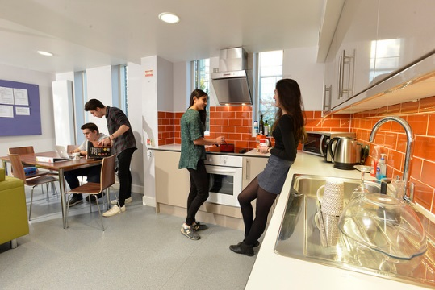
Colleges
A College is like a mini campus, providing a base for students. When considering Colleges, think about where you’d like to live – open application if you don’t mind.
Admit students
Academic and pastoral care
Accommodation, dining and recreation
Organise small-group teaching
Facilities for academic study
Notes:
Who does what – the Colleges
Colleges are students’ primary community – admit undergraduate students; organise small-group teaching (tutorials/supervisions – not always with tutors/supervisors at own College, where a relevant subject specialist is based at another College, will go to them for some tutorials/supervisions); responsible for academic and pastoral care; provide accommodation, places to eat, recreational and academic/study facilities
If decide to apply to one of our institutions, as well as selecting that University in UCAS application, will also be asked to select preference for a College (‘campus’):
Can either indicate a preference College or, if don’t mind, choose an ‘open’ application and you will be allocated a College– either option makes no difference to chance of being made an offer for equally well-qualified students. Colleges work together during admissions to make sure the best candidates receive offers, regardless of College choice.
Plenty of guidance on how to choose (and how not to choose) College on websites, but don’t spend too long trying to choose. At Oxford up to one third of places offered are not at a College specified on the UCAS application and at Cambridge around 1 in 4 students are made an offer from a different College.
It’s the Universities (not Colleges) which determine course content, and students from all Colleges on same course attend lectures, classes etc together in University academic departments – no Colleges ‘better’ for certain subjects
Additional background information
Oxford
34 Colleges and halls offering undergraduate courses.
1 college and 3 PPH’s exclusively for mature students (aged 21 or older when start course; but all UG Colleges accept mature applications) – Harris Manchester College, Blackfriars (Permanent Private Hall), St Stephen’s House (PPH), Wycliffe Hall (PPH)
Cambridge
29 UG Colleges
3 exclusively for mature students (though all UG Colleges accept mature applications) – Hughes Hall, St Edmund’s College, Wolfson College
2 Colleges consider applications for female students only – Murray Edwards College, Newnham College

Slide 15
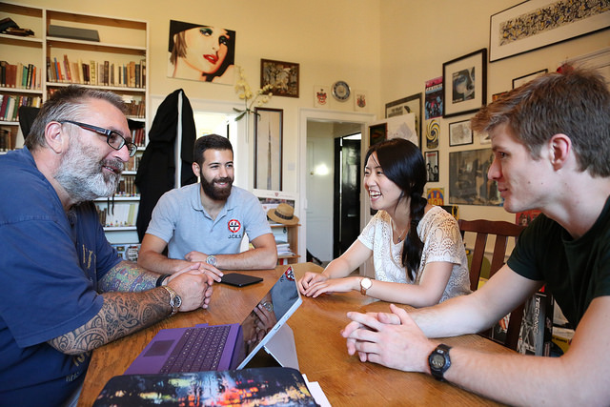

What are we looking for?
Academic ability and potential
Satisfy any subject requirements
Genuine subject interest – motivation
and enthusiasm
Good ‘fit’ between applicant and
course
Vocational commitment (where appropriate)
Assess applications holistically
Notes:
Admissions decisions based on academic criteria – high achieving students with potential to be successful at Oxford or Cambridge
We are looking for students who:
are high achieving and enjoy a challenge
have a sound knowledge base and range of skills, with the potential to go beyond the syllabus and use this knowledge in unfamiliar situations
are well suited to the course applied for and will benefit from/thrive in learning environment we offer including how we assess – i.e. mainly by exam
show genuine personal interest in their subject(s) through wider engagement, expressed through an interest in new ideas and an enthusiasm for reading/exploration around the subject
have self-discipline, self-motivation and commitment
We’re interested to hear about activities outside of or beyond school that are relevant to the course, but extracurricular activities won't increase your chance of being made an offer. It can help to show transferable skills and to contextualise your application though.
We consider all applications holistically and look at all parts of the application and aren’t looking for students from particular schools or backgrounds, just students who will enjoy the academic challenge of our courses.

Slide 16


















The application process
Choose your course
Choose a College or open application
Check admission assessment/ test registration deadlines
UCAS application
Additional application forms - Cambridge only
Submit written work and/or take admission assessment/ test
Interview (December)
Decision
(January)
Notes:
College: Re College/open application choice: lots of guidance on choosing a College on websites BUT don’t spend too much time deciding on a College/open application
Assessments: Check about arrangements for any admissions tests (Ox) / assessments (Cam) – may need to be pre-registered for them; test/assessment registration separate to UCAS application.
Registering: for pre-interview tests/pre-registered assessments:
- Please note some pre-registered assessments have different and earlier deadlines so do check.
- Cannot register self for pre-registered/pre-interview assessments – must do so via school/college or authorised centre.
- If currently attending a school/college, or recently graduated from one: ask exams officer if school can administer assessment for you. If school/college not already registered as one, can apply to become test centre. Please note: best get application in early as approval can take several weeks.
- If not attending a school/college: must find authorised centre where can take assessment. Authorised centres can administer assessments for all test-takers.
Also check the dates of registration and tests/assessments carefully – BMAT and pre-interview tests/assessments scheduled to be taken in early November.
Students should check if their course has an assessment on the relevant course page.
Interviews – Interviews usually taking place in December of the year you apply. Please check our websites for updates on whether interviews will be held online or in-person. For online interviews, the aims and content will still be the same as in-person interviews. If decide apply, keep time free of unbreakable commitments; more info and advice about interviews on our websites
Decision: final decisions made before end of January
Additional background information
Cambridge
UCAS application deadline may be earlier than 15 Oct for some international students and some mature applicants applying to a mature College may be able to submit UCAS application later than 15 Oct – in all cases, see website for details
If applicable/used, Extenuating Circumstances Form (see below) must be submitted by applicant’s school/college by 22 Oct (or doctor/social worker, if school/college unaware of the circumstances)
Additional Application forms (Cambridge)
Collects information not in UCAS application useful when assessing applications, eg A Level (or equivalent) topics (helpful for interviewers when deciding what questions to ask)
Automatically emailed to applicants once UCAS application received, and must be completed/submitted by deadline (most cases 22 Oct/week after UCAS application deadline)
Extenuating Circumstances Form (Cambridge)
Has been designed to ensure that the Cambridge Colleges have the information they require in order to accurately assess any applicants who has experienced particular personal or educational disadvantage – students apply in usual way, Extenuating Circumstances Form completed by school/college referee (or doctor/social worker, if appropriate).
This form should only be used where an applicant’s education has been significantly disrupted or disadvantaged through health or personal problems, disability or difficulties with schooling.
Further details and the Extenuating Circumstances Form are available online.
Extenuating Circumstances (Oxford)
Should be raised in teacher’s reference or directly with College stated preference for/allocated, if making open application

Slide 17

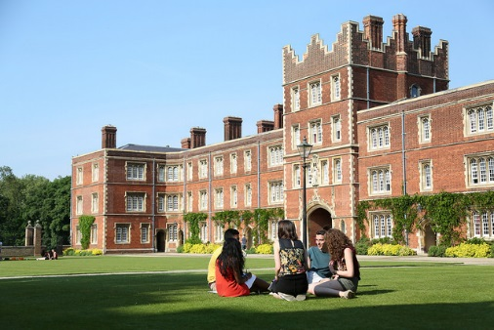

What information do we use to assess applications?
No part of an application is considered in isolation – all available information is looked at together before decisions are made. We consider every application individually, taking all aspects into account:
Academic record
Personal statement
Teacher’s reference
Performance in any admission test /
assessment (where required)
Written work (where required)
Contextual information and data
Interview (if interviewed)
Notes:
Admission to O&C highly competitive so to fairly assess our applicants we look at all available aspects of each application; and all available elements considered together/collectively/holistically, nothing considered in isolation
Performance in any admissions test (Ox)/ written assessment (Cam) and/or submitted written work (if required). We strongly encourage you to make use of the online resources available on the university websites to help you prepare for admissions tests and assessments - this will help you perform to the best of your abilities on the day.
Not all applicants invited to interview – Everyone with a good chance of being offered a place is invited to attend an interview. Number of students interviewed might vary by course.
Depending on group, may want/need to reiterate that for those who are interviewed the interview not ‘final hurdle’ – interview performance considered in conjunction with all other elements of application before final decisions made (ie performance at interview alone does not determine the outcome of an application)
Information about admission tests/assessments, written work, interviews available on our websites
Additional background information
Contextual data may include, for example (further details available on University’s websites):
applicant’s school’s performance at GCSE
applicant’s school’s/college’s performance at A Level (or equivalent)
The percentage of students eligible for free school meals at the applicant’s school or college at GCSE or equivalent level.
whether applicant has spent any time in care (indicated in UCAS application)
levels of progression to higher education
socio-economic deprivation

Slide 18
Preparing to apply
Do your research
Course choice is the most important decision – research thoroughly, personal interest(s)
Engage and explore
Be proactive in your learning – current studies and interests relevant to your intended degree
Results
Work hard to do as well as you can
Practise
Discussing your academic interest(s)
Past/example admission test/assessment papers
Time management – generally and for exams
Notes:
Do your research
Think carefully about course choice
Look closely at structure and content of courses at different institutions – course with same/similar name at different universities can vary greatly
Will be studying to a high level for a number of years so need enjoy course/have genuine personal interest to be motivated, committed and successful
Be open minded, think about academic and wider interests, and don’t just restrict yourself to ‘obvious’ and familiar course titles (other options may better suit/satisfy particular interests) – we’re looking for students who are well suited to the course chosen
Practicalities – check entry and subject requirements for courses interested in, and whether admission test (Ox) or admission assessment (Cam) required (and, if so, if need to be registered in advance, and when test/assessment will take place)
Engage and explore
Key difference between school/college and university is level of independent study expected and required
We look for evidence that you’re already ‘going the extra mile’ – exploration beyond what’s needed for your current studies (supplement your learning and challenge yourself); finding ways to pursue interests that are relevant to the course you wish/intend to study at university
Results
Need to be doing well at the moment to be prepared for our courses- see course pages on websites for admissions requirements
If you have any extenuating circumstances, important that Admissions Tutors are advised of these circumstances – make sure school/college referee includes information in their reference (see online and seek advice from Colleges)
Practise
Get used to discussing your work and academic interests (with friends, family, teachers), and talking through your thought processes – not only useful preparation for interview but also for tutorials/supervisions
Think critically and analytically about what you’re reading and learning
If will need to take an admissions test (Ox) / written assessment (Cam), look on our websites for supporting/preparation materials/resources (where relevant, may be past/example papers you could try – if so, make sure you do at least one in strict timed conditions; and don’t do them all at once, keep one or two for close to the time you’ll take the actual test/assessment)
Note: we are aware of private companies/individuals that offer, at a charge, information and advice on our admissions processes, assessments and interviews – we DO NOT support or encourage any of these commercial enterprises. None has access to any information not already available free of charge from the University Admissions Office, Colleges and University Students’ Unions; and we cannot verify the accuracy of the information private companies/individuals may provide.

Slide 19
What to do now ?- Students
Students- Keep an eye on your school emails and Satchel one for important messages from Careers advisor , Mrs Greenwood, Progress leader etc.
Work hard to maintain high grades
Revise for Year 11 mock exams
Start looking at super curricular websites- see what interests you.
Consider your course choices at A level- What interests you and what is needed for University courses. Eg Chemistry is needed for Medicine.
You can also go to University open days in year 11
Visit the open days website for dates:-
https://www.opendays.com/

