Slide 1

Benefits of going to university and student finance

Slide 2
Why go to university?
Higher paid jobs
Wider employment opportunities
Faster progression to senior roles
Study subjects in greater detail
Meeting new friends
Independence
Life skills – cooking and learning to use a washing machine!
Trying something new
Improved self-discipline and time-management – key employability skills

Slide 3
Why go to university?
School holidays! (June-September – can work part time)
Student discounts – NUS, Student Beans, UniDays
Opportunities for work experience or to travel abroad

Slide 4

Apply
Assessed
Receive finance
Go to university!
Loans:
You start paying back when you’re earning
Maintenance loan
Tuition loan

Slide 5
Understanding student finance
“How much does university cost?”
How much student finance you have and how much it costs you are two very different things

Slide 6
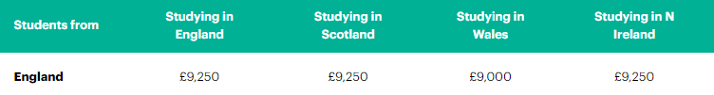
Student finance: Tuition fees
This is the maximum that they can charge.
They never charge you directly. This money is paid directly to the university on your behalf – you never see this money.

Slide 7
Student finance: Tuition fees – what do they pay for?
Tuition fees pay for:
The teaching you will receive
  Lectures
  Seminars
  Tutorials
Buildings
Services
Staff
Hardship funds for struggling students
While you don't get any say in how much universities charge, it's still worth checking they spend fees in the ways that most benefit you.
That could be through more teaching time, a well-stocked library, cutting-edge facilities, career mentoring, or anything else that helps you get you a degree or a job after graduating.

Slide 8
Student finance: Tuition fees – what don’t they pay for?
Tuition fees don’t pay for:
Getting to and from uni
Accommodation
General living costs
Books
Science lab / sport equipment
Field trips
(Printing)
(Photocopying)
These types of things you will need to budget for from your maintenance loan

Slide 9
General living costs
Now is a good time to talk about budgeting and being money-wise
Making meals in bulk and freezing them
Aldi do weekly videos – 5 meals for £25
Healthy eating/balanced diet
Food shop --->
Electricity
Gas
Internet
TV licence
Council Tax
Water
Insurance – it is worth insuring laptops/phones at university in case of accidental damage/theft etc

Slide 10
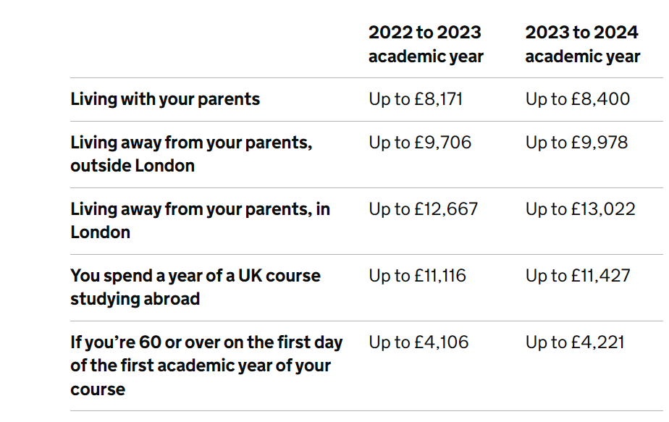
Student finance: Maintenance loan (living costs)
The maintenance loan is means-tested (based on the household income).
Use this online tool to work out an estimate:
https://www.gov.uk/student-finance-calculator/y

Slide 11
Student finance: Maintenance loan (living costs)
It is paid directly into your bank account once a term
September/January/April
Due to the summer holidays, the April funds will usually need to last you over the summer, unless you find a part-time job
You can spend it on anything you like and without budgeting you could end up with no money for weeks if not months.

Slide 12
Budgeting
Start a spreadsheet
UNI & COURSE | TRAVEL COSTS HOW MUCH WILL IT COST YOU TO COME HOME ON THE TRAIN/BUS/CAR | ACCOMMODATION CHECK WHAT IS INCLUDED ENSUITE OR NOT? DO YOU HAVE TO PAY OVER THE SUMMER HOLS? DEPOSIT? | GYM SOMETIMES THIS IS INCLUDED IN UNI ACCOMMODATION FEES | INCLUDE OTHER THINGS HERE THAT ARE IMPORTANT TO YOU MEALS OUT/COFFEE/CAR PARK CHARGES IF YOU TAKE YOUR CAR
UNI OF BHAM
UNI OF MANCHESTER
UNI OF BATH
You can also include entry requirements, bursaries, contextual offers, etc and make notes if you visit for an Open Day

Slide 13
Student finance: Paying back your loan – PLAN 5
You repay 9% of everything earned above £25,000 – earn less and you don't repay anything
You start repaying in the April after you have graduated
After 30 years, the debt is written off – 83% will never pay off their loan
The ‘debt’ doesn’t go against your credit rating or any mortgage applications

Slide 14
Plan 5 - The thresholds will be £480 a week or £2,083 a month (before tax and other deductions).
Example
You’re paid monthly and your income changes each month. This month your income was £2,250, which is over the Plan 5 monthly threshold of £2,083.
Your income was £167 over the threshold (£2,250 minus £2,083). You will pay back £15 (9% of £167) this month.
Example
Your annual income is £33,000 and you’re paid a regular monthly wage. This means that each month your income is £2,750 (£33,000 divided by 12). This is over the Plan 5 monthly threshold of £2,083.
Your income is £667 over the threshold (£2,750 minus £2,083). You will pay back £60 (9% of £667) each month.
P1: Be prepared for life post-sixth form with a final destination of either university, apprenticeship or place of employment with at least 3 Level 3 qualifications

Slide 15
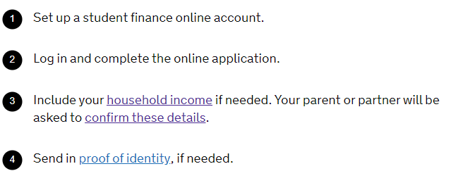
Applying for finance
https://www.gov.uk/apply-for-student-finance
P1: Be prepared for life post-sixth form with a final destination of either university, apprenticeship or place of employment with at least 3 Level 3 qualifications

Slide 16
Student finance
Recap:
  Tuition fee loan – paid directly to your university to cover the costs of your lectures etc.
  Maintenance loan – paid directly to you, 3 times a year. The amount you will receive is based on your ‘household’ income
  You don’t need to worry about paying it back. It automatically comes out of your salary when you are earning over £25,000 a year
  When applying for a mortgage, car on finance, or a credit card (etc) your student loan won't affect this
P1: Be prepared for life post-sixth form with a final destination of either university, apprenticeship or place of employment with at least 3 Level 3 qualifications

Slide 17
Student finance: When to apply
It hasn’t been announced yet but usually opens at the beginning of March.
Easiest way is to apply online but you can request paper copies if required
You can apply before or after you confirm your university choice
If you apply with less than 4 weeks before your course starts, you will receive some money but not your full entitlement
P1: Be prepared for life post-sixth form with a final destination of either university, apprenticeship or place of employment with at least 3 Level 3 qualifications

Slide 18
Student finance: What do you need?
You will need proof of identity.
  Passport
  Birth certificate
Household income
  They will email your ‘household income’ providers where they will need to state their income and possibly provide evidence
  This is checked against HMRC’s database
P1: Be prepared for life post-sixth form with a final destination of either university, apprenticeship or place of employment with at least 3 Level 3 qualifications

