Slide 1

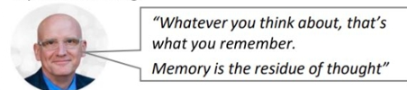
How to revise effectively
Learning is the long-term retention of knowledge and the ability to transfer it to new contexts (Didau)
It is a change in your long-term memory
We know that for information or skills to be learnt and stored in your long-term memory, the mind must work hard!
Key message:
When doing any revision activity, you must do things which actively make you think hard
Daniel Willingham

Slide 2
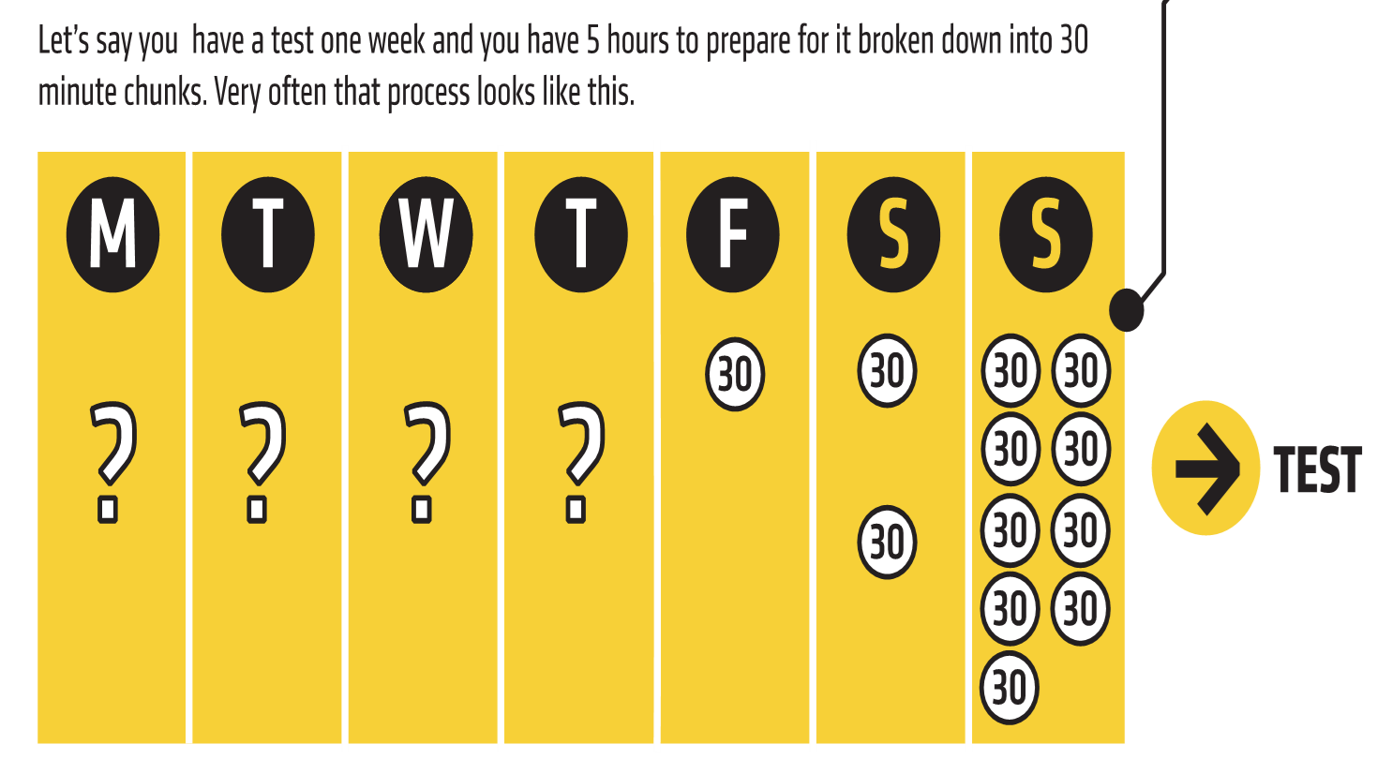
Or
Which one is more suitable?
Why?

Slide 3
Different types of revision:
Active revision:
Quizzing: Self-testing to assess knowledge and understanding.
Flashcards: Creating bite-sized pieces of information for quick review.
Graphic organizers: Using diagrams, mind-maps, and flowcharts to visualize and organize information.
Teaching the subject to others: Explaining concepts to someone else to reinforce understanding.

Slide 4
Passive revision:
Re-reading: Going through the material multiple times to reinforce memory.
Highlighting: Marking important sections in the text for quick reference.
Recording yourself reading notes: Listening back to recorded notes for auditory reinforcement.

Slide 5
Collaborative revision:
Group study: Discussing and explaining concepts with peers.
Peer feedback: Receiving and providing constructive feedback on each other's understanding.

Slide 6
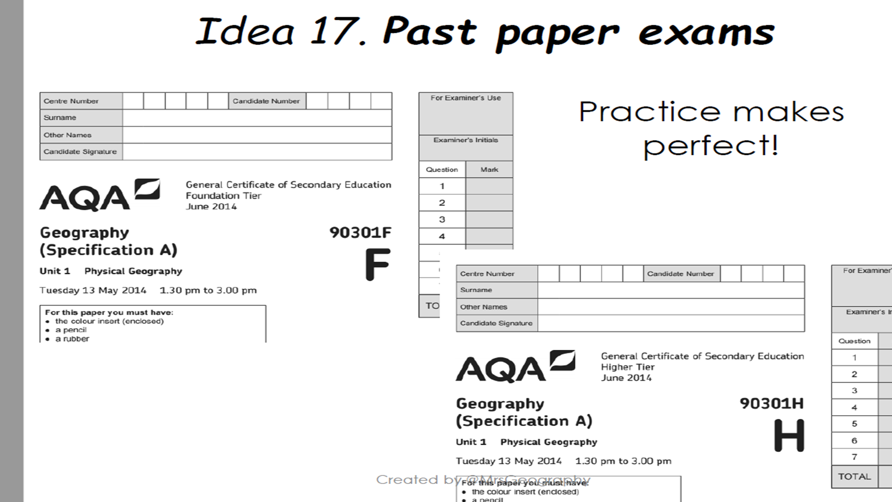

Slide 7
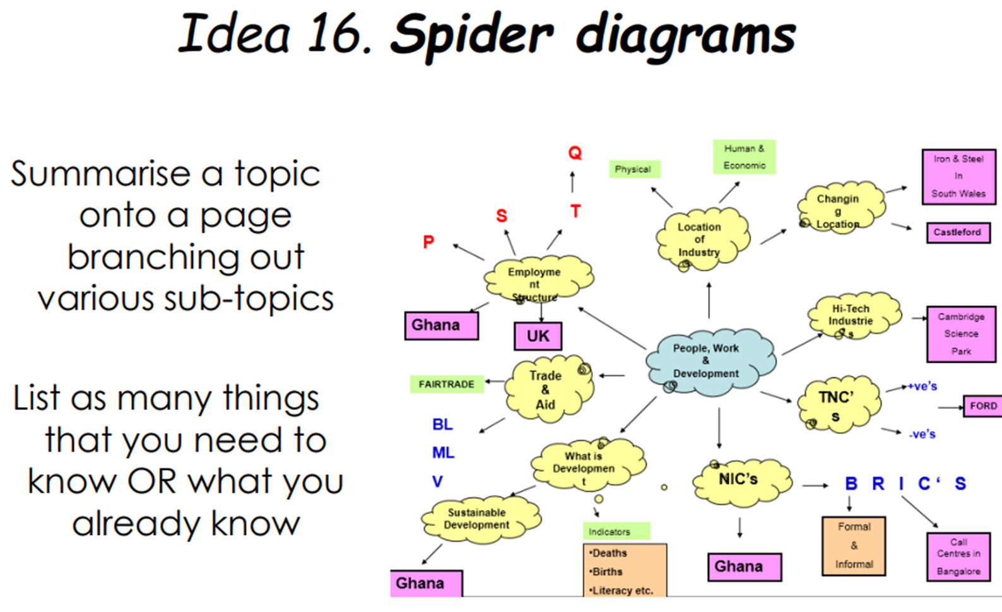

Slide 8
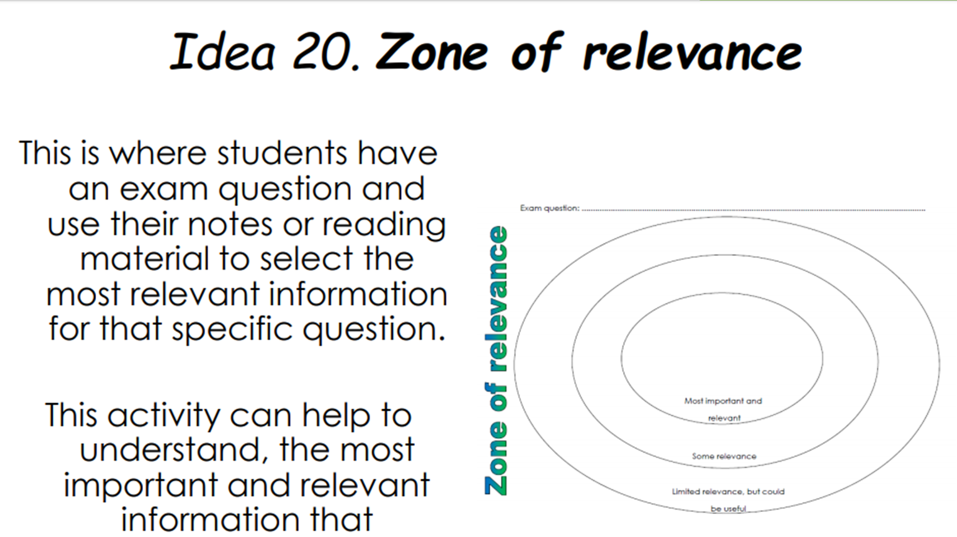

Slide 9
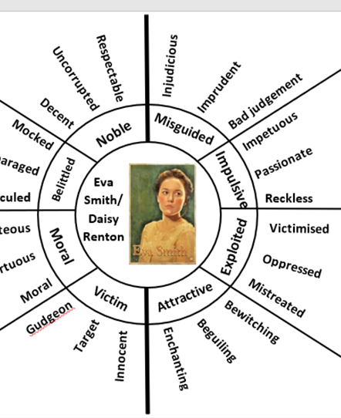
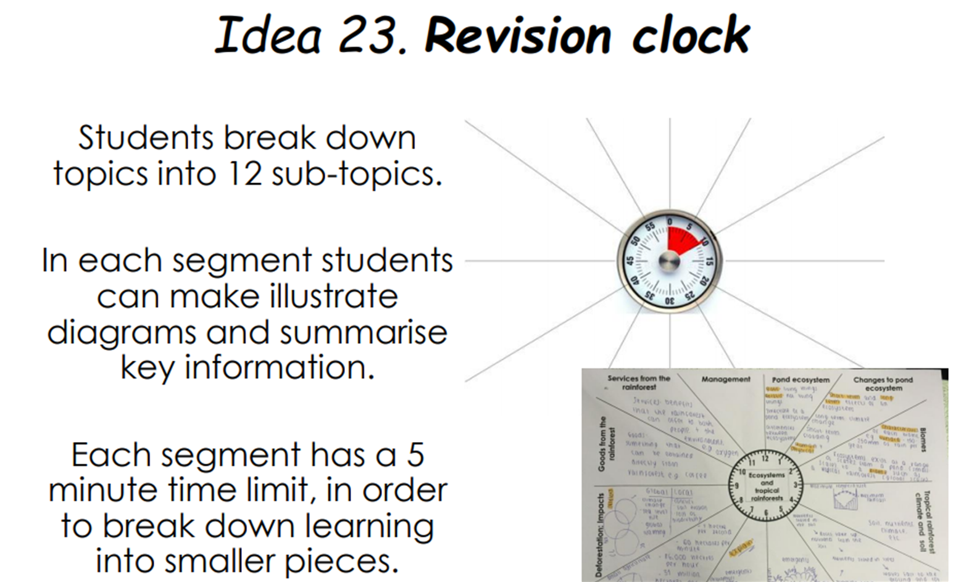
You can do this yourself by creating knowledge organiser and other tools.
In the English Department we have created many of these tools for you, including revision clocks, word wheels and other resources.
Visit the Blended Learning Platform to find them.

Slide 10

Year 10- Aim higher evening
14th March 5pm -6.30pm for parents and students
Information regarding your Post 16 and post 18 options and how to succeed in your GCSEs
9 different sessions on various pathways:
  University
  Apprenticeships
  Careers
  Revision
You can choose 3 sessions to attend
Letter home today to parents and carers - MS form link in the letter to choose your sessions
Reply by Monday 4th March - 2 weeks!

Slide 11


Any questions????
If you think of anything in the meantime, please see any of year 10 tutors or Miss. Hinton

