Slide 1
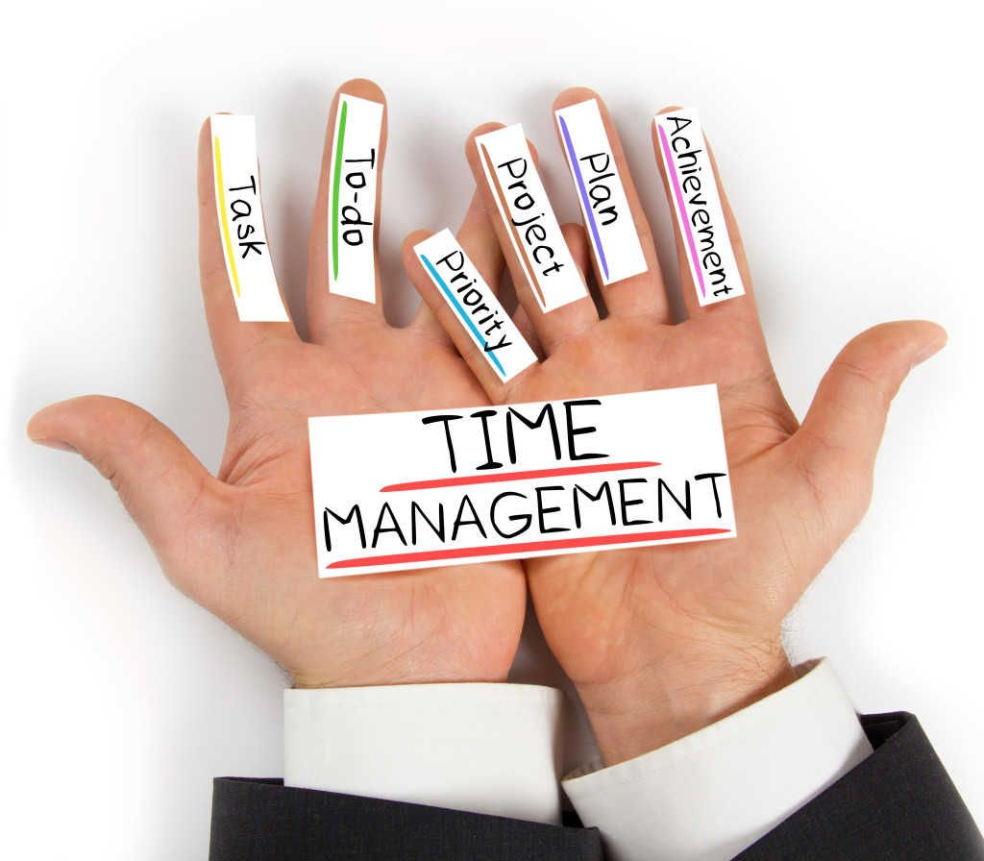
The importance of Time Management

Slide 2
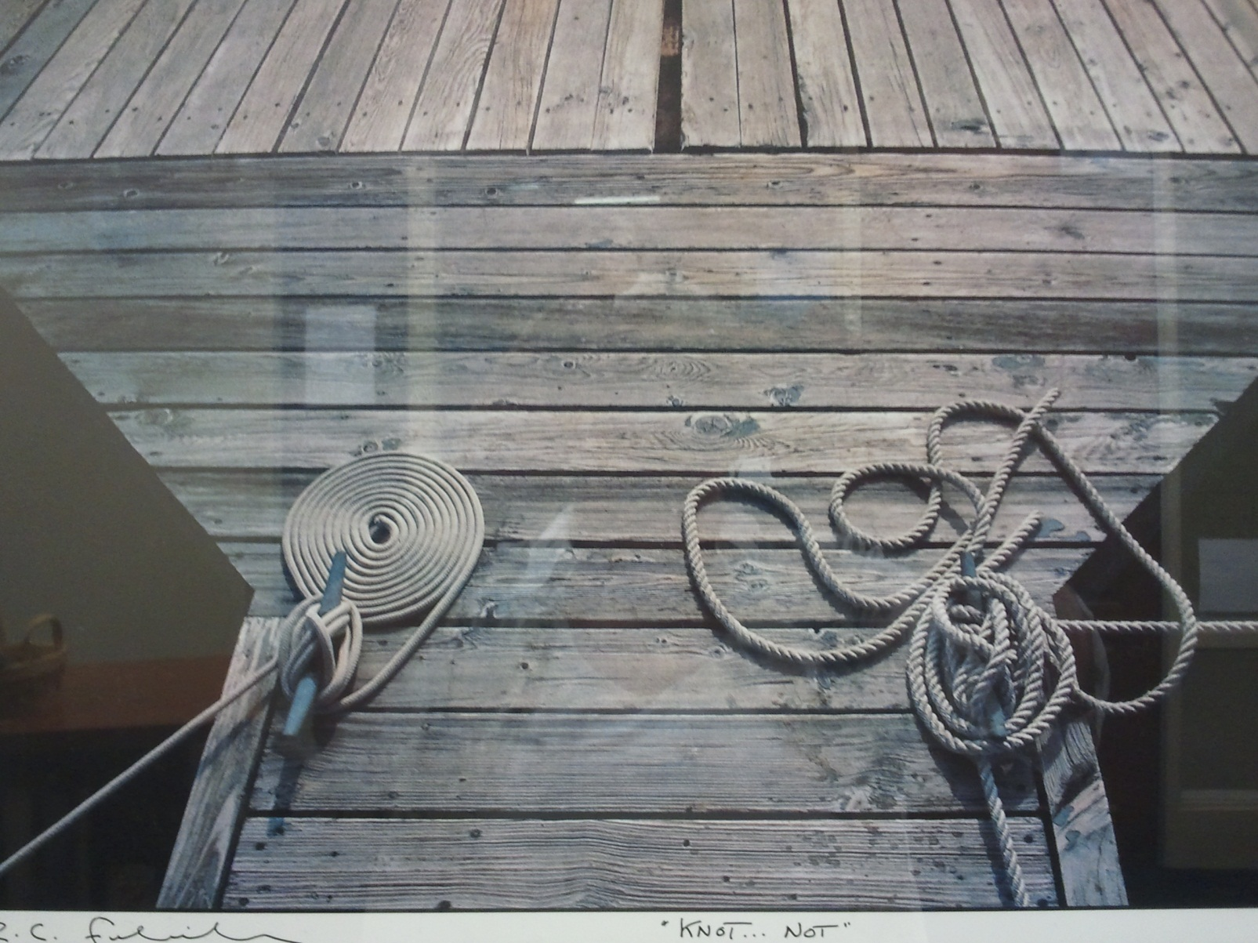
Two Types of People

Slide 3
Myths about Time Management
Time management is nothing but common sense. I do well in school, so I must be managing my time effectively.
It takes all the fun out of life!!!
Time management? I work better under pressure.
No matter what I do, I won’t have enough time!

Slide 4
The Truth About Time Management
Increases productivity.
Reduces stress.
Improves self-esteem.
Helps achieve balance in life.
Increases self-confidence
Helps you reach your goals!

Slide 5
There are 168 hours in a Week
 | Urgent | Not Urgent
Important | Do Now | Plan to Do
Not Important | Reject Interruptions and distractions Scrutinize and probe demands. Help originators to re-assess. Wherever possible reject and avoid these tasks. | Resist ‘Comfort’ activities, computer games, social media Screen time and gossiping Daydreaming, doodling over long breaks Unnecessary adjusting equipment Habitual ‘comforters’ not true tasks. Non-productive, de-motivational. Minimize or cease altogether. Plan to avoid them.

Slide 6

Steps to Managing Your Time
Set goals
Set reasonable expectations (and remember that no one’s perfect)
Make a schedule
Revisit and revise your plan

Slide 7

Where to start? Set Goals!
What is Important?
Make your goals specific and concrete. Don’t be vague.
Set both long-term goals and short-term ones to support them.
Set a deadline for your goals.
Realise that goals change, but know which goals to stick to!

Slide 8

From Goals…Set priorities
What’s important and what isn’t?
What order do things need to be done in?
Once you know what your priorities are, you need to plan out a schedule for the term, the week and the day.
Planning may seem hard at first, but the more you do it, the easier and more natural it gets.

Slide 9
Make a Schedule
Set Up Your Term Calendar
Block out all important set time obligations.
Block out all time in school.
Look at the syllabus for the class schedule.
  Note the weight of the activities.
  Highlight all exams and project due dates.
Work backwards from exams and papers
Study time.
Time for your sanity!!

Slide 10
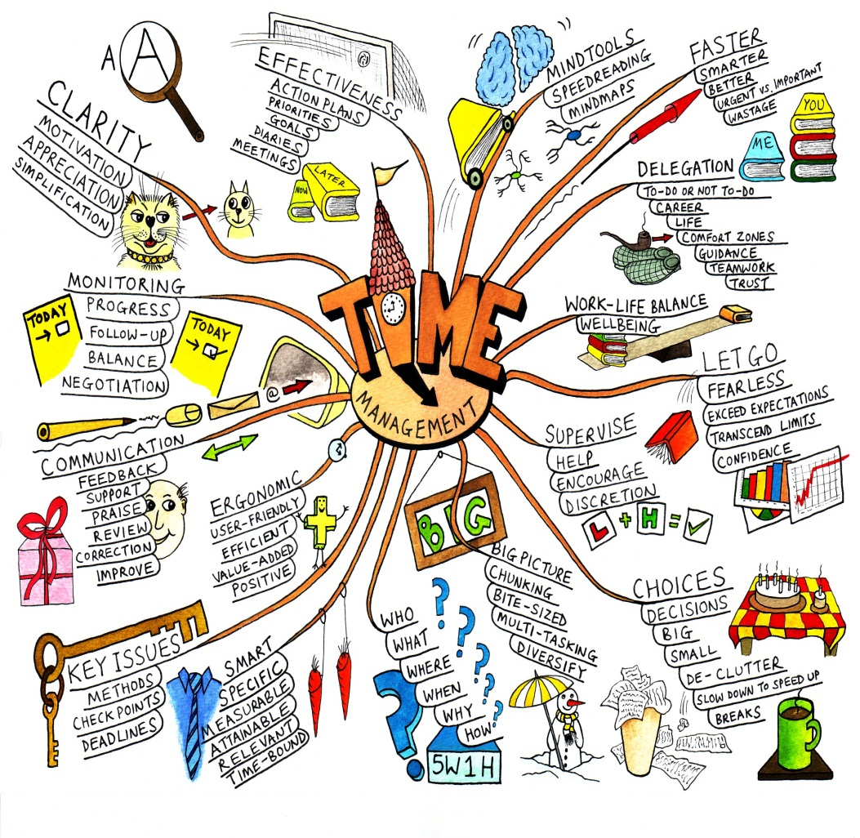
Organizing Your Time
Set realistic goals, there are only 24 hours in a day.
Use spare time to review.
Study at the same time each day: make it a habit
Divide study time into manageable chunks
Leave extra time at the end!

Slide 11
Calendars
Different Perspectives – find what works for you!

Slide 12
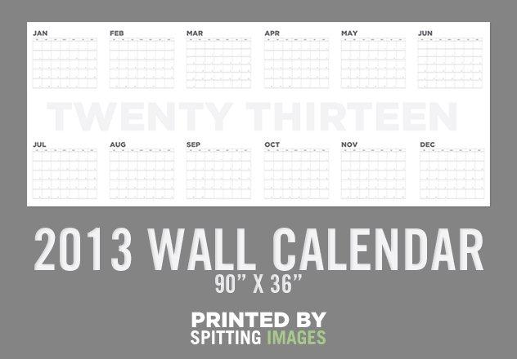
Year Calendar

Slide 13
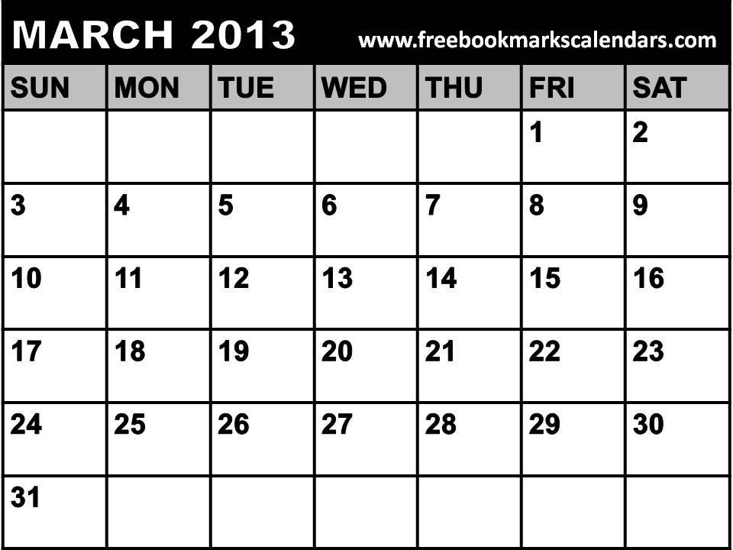
Monthly Calendar

Slide 14
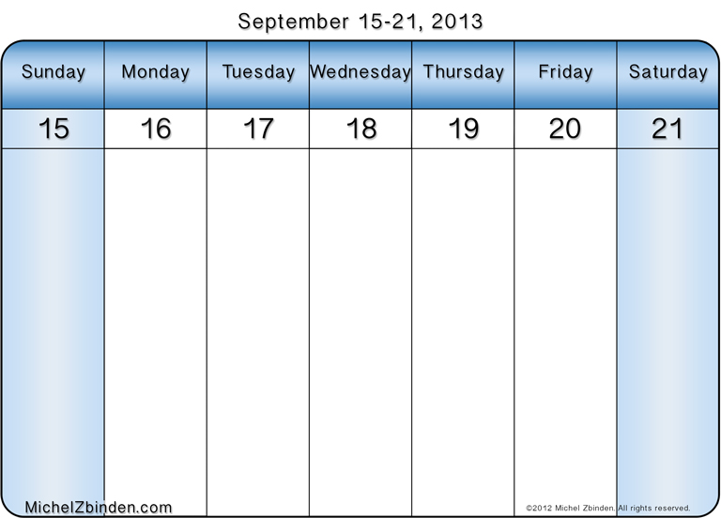
Weekly Calendar

Slide 15

Try it and evaluate your plan!
How are you actually using your time?
Which tasks were you able to do? What didn’t get done?
Was your energy level appropriate? Your stress level?
What changes need to be made to your weekly schedule?
What are persistent time wasters?
Was procrastination an issue?

Slide 16
“Never do today what you can put off ‘til tomorrow!”

Slide 17
Forms of procrastination:
Ignoring the task, hoping it will go away
Underestimating how long it will take/overestimating your abilities and resources
Telling yourself that poor performance is okay/insisting on perfection
Doing something else that isn’t very important
Believing that repeated “minor” delays won’t hurt you
Talking about rather than doing it
Putting all your work on only one part of the task

Slide 18

How to Overcome Procrastination
Win the mental battle by committing to being on time.
Set and keep deadlines.
Organize, schedule & plan.
Divide a big job into smaller ones.
Find a way to make a game of your work or make it fun.
Reward yourself when you’re done.
Tell your friends and family to remind you of
priorities and deadlines.
Learn to say “no” to time wasters.

Slide 19

Miss Harris’ Top Revision Tip!
We are all tempted to do the revision we find the easiest first but this will be ineffective to develop those areas you are weaker on.
Instead:
“Revise the hardest/most boring topic first, then move onto the nicer topics”

Slide 20
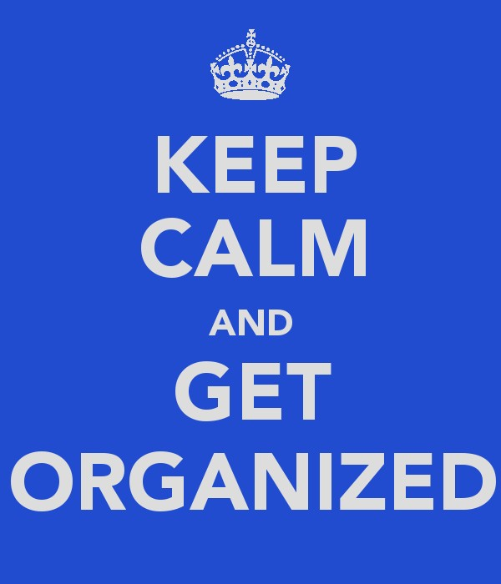

Slide 21
Re-cap
Time and energy management can make you more productive and reduce your stress level.
The Three Steps
  Set goals
  Make a schedule
  Revisit and revise your plan
Be tough with your time. Actively avoid procrastination and time wasters. Learn to say “no” to distractions.
Employ a variety of time management strategies to maximize your time.
Relax and enjoy the extra time that you’ve discovered!

Slide 22
Enjoy your time as a student! It is the best time of your life!

